Slide 1
Linear Algebra
Shaurya Prakash
II Semester , Ph.D
Instructor: Dr. S.Karthikeyan
Department of Computer Science,
BHU , Varanasi

Slide 2
Outline
Transpose
Inverse
Vectorization
Eigen Values and Vectors
Applications of Eigen Vectors

Slide 3
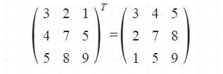
Transpose
Interchange row and columns.
Uses : To make matrix operation compatible.

Slide 4
Why do we go for Transposition?
2 3 3 4
3 4 X 5 6 = Not Compatible..
5 6 4 8
2 3 3 4 5 18 26 34
3 4 X 4 6 8 = 25 36 47
5 6 39 56 73

Slide 5
Transpose
2 3 3 4
3 4 X 5 6 = Not Compatible..
5 6 4 8
2 3 4 3 4 43 66
3 4 6 5 6 = 55 84
4 8

Slide 6
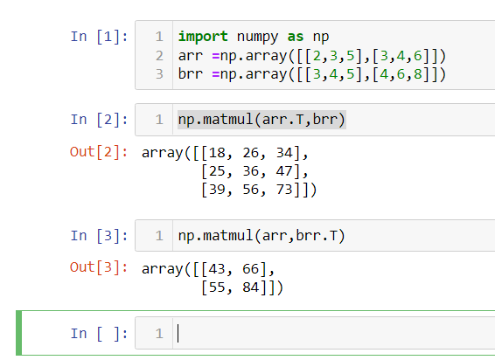
Example

Slide 7
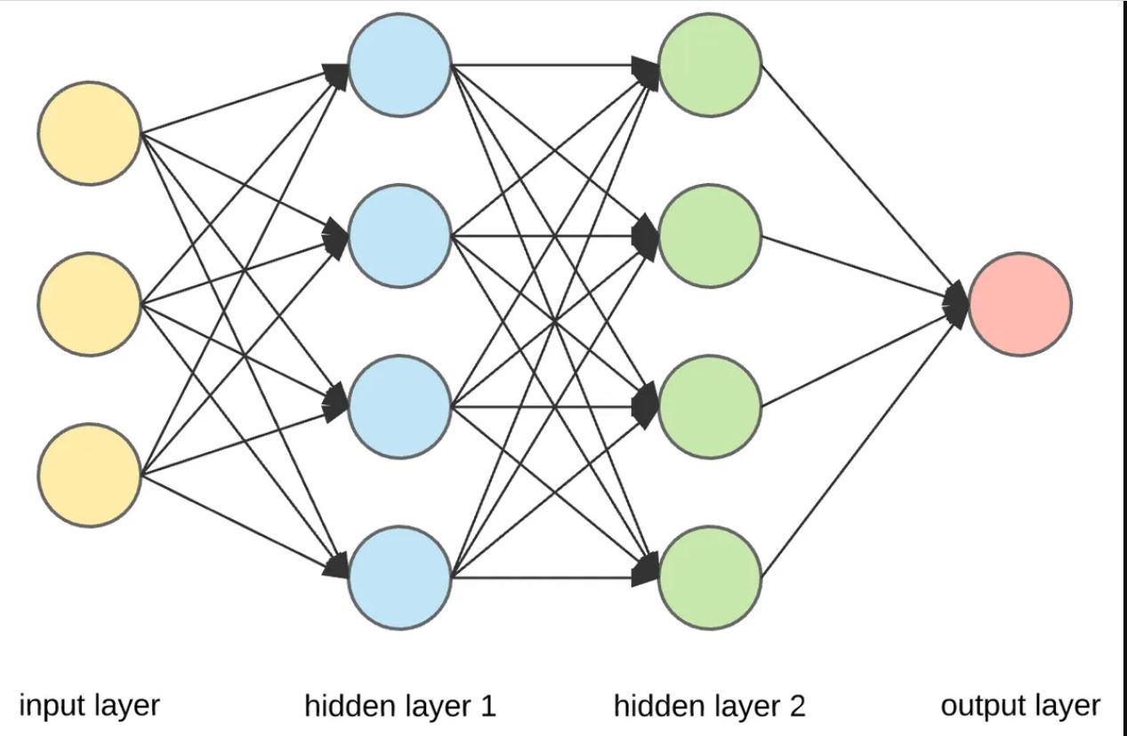
Uses of Transpose
Evaluation of weight matrix and aggregate value:

Slide 8
Using Transpose To Develop a Model for Neural Networks
x₁ w₁₁ w₂₁ w₃₁ w₄₁ b₁
A^{[1]}= x₂ W^{[1]} = w₁₂ w₂₂ w₃₂ w₄₂ b^{[1]} = b₂
x₃ w₁₃ w₂₃ w₃₃ w₄₃ b₃
(3x1) (3x4) b₄
Note : A and W cannot be multiplied directly.
z^{[L]} = W^{[L]T}*A^{[L-1]} + b^{[L]}

Slide 9
Using Transpose To Develop a Model for Neural Networks : Change W to W^{T}
x₁ w₁₁ w₁₂ w₁₃ b₁
A^{[1]}= x₂ W^{[1]T}= w₂₁ w₂₂ w₂₃ b^{[1]} = b₂
x₃ w₃₁ w₃₂ w₃₃ b₃
w₄₁ w₄₂ w₄₃ b₄
z^{[L]} = W^{[L]T}*A^{[L-1]} + b^{[L]}

Slide 10
Using Transpose To Develop a Model for Neural Networks : Plug it into expression.
w₁₁ w₁₂ w₁₃ x₁ b₁ W^{[1]T}= w₂₁ w₂₂ w₂₃ * x₂ + b₂
w₃₁ w₃₂ w₃₃ x₃ b₃
w₄₁ w₄₂ w₄₃ b₄
Vector(4x1) Vector(4x3) Vector(3x1) Vector(4x1)
z^{[1]} = W^{[1]T}*A^{[0]} + b^{[1]} (Successfully computed !!)

Slide 11
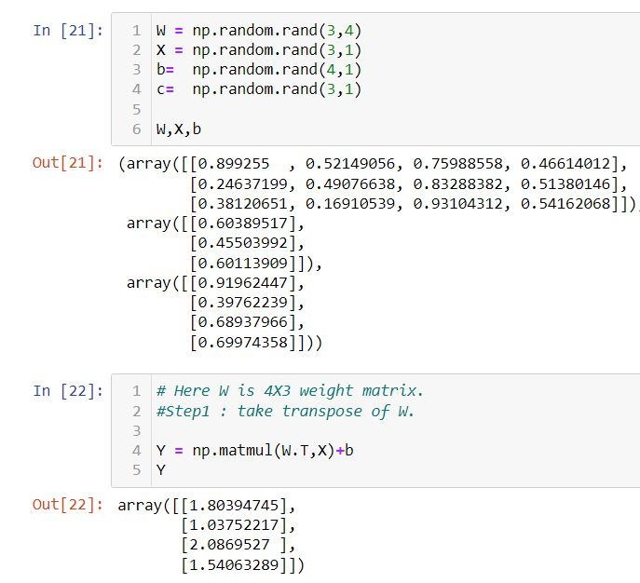
Example

Slide 12
Sanity Check (For each layer)
Number of outputs = Number of neurons.
4 = 4
Number of Inputs = Number of Columns in W^{T} .
3 = 3
Number of outputs = Number of bias vector element.
4 = 4
Number of rows in W^{T} = Number of neurons.
4 = 4

Slide 13
Inverse of Matrices
Invertible Matrices ?
Simple telltale signs for invertible matrices !!
Matrix is full rank.
The determinant of is not zero.
The matrix has non-zero singular values.

Slide 14
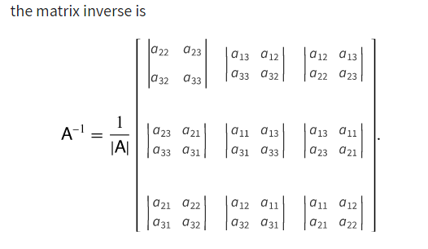
Inverse of Matrices
The inverse of a square matrix , sometimes called a reciprocal matrix, is a matrix such that
AA⁻¹ = I (Identity Matrix)

Slide 15


Inverse of Matrices
(AB)⁻¹ ⁼ B⁻¹A⁻¹
AA⁻¹ = I (Important)
A^{T} = A⁻¹ , A^{T}A =I (Important :symmetric matrices)
Inverse of Diagonal Matrices

Slide 16
What is a Matrix?
It is a transformation.
Inverse will exist if a non singular matrix A has a unique matrix A⁻¹ such that AA⁻¹ = I .
Relation between A ,A⁻¹ ~ x ,f(x).
This concept is exploited in change of basis transformation.

Slide 17
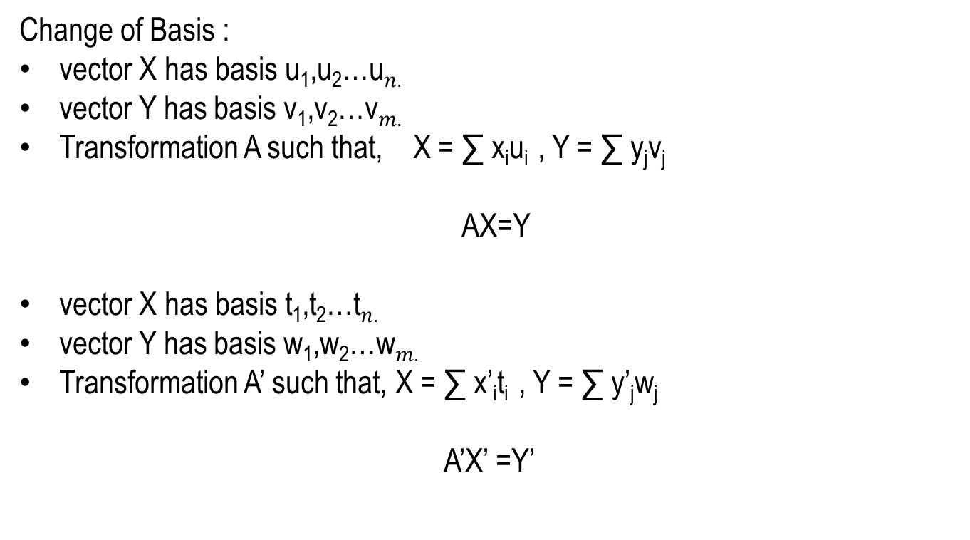
Inverse of Matrices : Uses
Change of Basis :
vector X has basis u₁,u₂…u$n$.
vector Y has basis v₁,v₂…v$m$.
Transformation A such that, X = ∑ x_{i}u_{i} , Y = ∑ y_{j}v_{j}
AX=Y
vector X has basis t₁,t₂…t$n$.
vector Y has basis w₁,w₂…w$m$.
Transformation A’ such that, X = ∑ x’_{i}t_{i} , Y = ∑ y’_{j}w_{j}
A’X’ =Y’

Slide 18
Inverse of Matrices : Uses
Change the each basis component to target component
t_{i} = ∑ t_{ji}v_{i} , w_{i} = ∑ w_{ji}u_{j}
Basis for B_{t} = [t₁,t_{2………..}] , B_{w} =[w₁,w₂…]
A’X’=Y’
AB_{t} X’=B_{w}Y’
B⁻¹_{w} AB_{t} = A’

Slide 19
Example
A vector is rotated through α degrees. Find transformation matrix. (NND Matrix representation page 6.6)
X be a vector , AX be the transformed vector.
If we rotate s₂ α degrees anticlockwise , transformation of s2.
If we rotate s₁ α degrees anticlockwise , transformation of s1.
AS₁ = s₁cos(α) + s₂sin(α) AS₂ = s₁cos(90+α) + s₁sin(90+ α)
Combining AS = cos α -sin α s1
sin α cos α s2
Here Matrix is rotation transformation.
_{AX}
_{X} AS₁
α = 60
AS₂
s₂
s₁

Slide 20
Vectorization : Revisit the network.
Rows
z^{[L]} = W^{[L]T}*A^{[L-1]} + b^{[L]}
Columns

Slide 21

Vectorization
Input : X = (3x1)
Layer 1 : W^{T} = (4x3)
Layer 2 : W^{T} = (4x3)
Layer 3 : W^{T} = (1x4)
Output : Y = (1x1)

Slide 22
Eigen Values and Vectors
AX =λI
(AX –λI) = 0
We get values for λ , called eigen values and eigen vectors.
Eigen is all about scaling without invariance i.e. eigen vectors are those vector whose dirction do not change after a transformation.

Slide 23

Eigen Values and Vectors
Shock absorber should only change dimensions linearly .
So direction of shock absorber should be along eigen vectors.

Slide 24
Eigen Values and Vectors :Uses
Learning Rates :
α = 2/ λ_{max} (Steepest Descent)

Slide 25
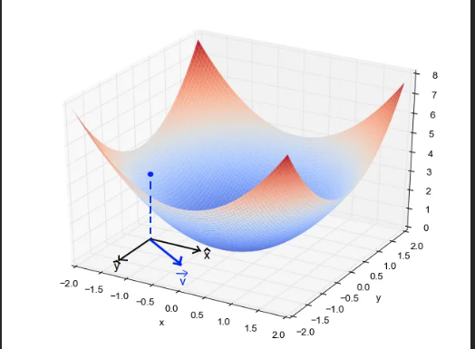
Eigen Values : Performance Surfaces
λ_{max} is largest among all eigen values.
λ_{i} > 0 , for each I . Positive Definite , Global Mininma , Strong Minima

Slide 26
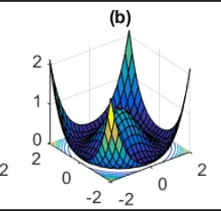
Eigen Values : Performance Surfaces
λ_{i} >= 0 . Positive Semi Definite. Weak minima. No Global minima.

Slide 27
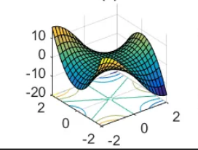
Eigen Values : Performance Surfaces
λ_{i} are negative and positive , saddle point.

Slide 28
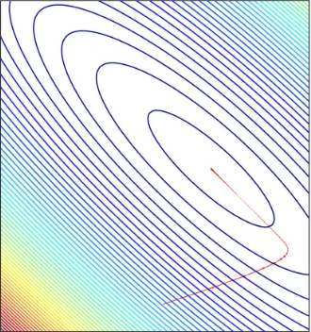
Eigen Values : Magnitude
Magnitude of eigen value is proportional to the rate of contour crossing , irrespective of sign of eigen values.

Slide 29
Eigen Values : Magnitude
Magnitude of eigen value is proportional to the rate of contour crossing , irrespective of sign of eigen values.
In case of Steepest descent , maximum gradient of a surface is along eigen vector, corresponding to largest eigen value.
Steepest descent is special case of gradient descent .

Slide 30
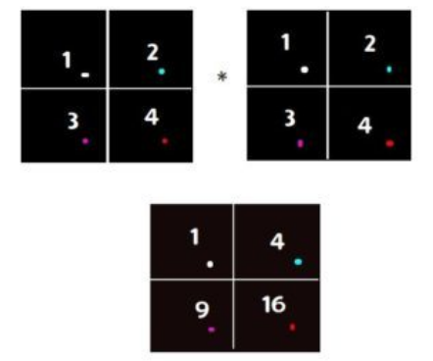
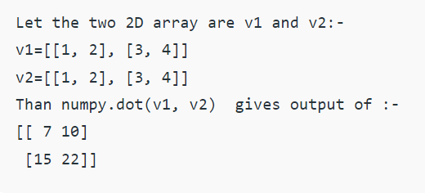
Multiplication : Element wise and Dot
Element wise
Dot

Slide 31
References
[1] . Laurene Faussett,An Introduction to Artificial Neural Network. PearsonPublisher, 2018.
[2] .Jacek M. Zurada,Introduction to Artificial Neural Network. City:St.Paul Jaico Publisher, 2008, p.1-251.

Slide 32
Exploring More…
Thankyou

